Slide 1
(Scrum)
Software Development
Prof. Dr. Dirk Riehle
Friedrich-Alexander University Erlangen-Nürnberg
AMOS E01
Licensed under CC BY 4.0 International
Notes:
It is Friedrich-Alexander University Erlangen-Nürnberg – FAU, in short.
Corporate identity wants us to say “Friedrich-Alexander University”.

Slide 2
Agenda
Software developer
Sprint planning
Day planning
Code ownership
Build management

Slide 3
1. Software Developer

Slide 4
Software Development Team (Recap)
The software development team
  Holds overall responsibility for delivering working software
    That provides the features the team committed to delivering

Slide 5
Primary Role Responsibilities (Recap)
Engineering Management
  Who?
    By when?
Software Development
  How?
    How fast?
Quality Assurance
  Releasable?
    Good enough?

Slide 6
Traditional to Scrum Role Mapping (Recap)
Traditional
Scrum
Product Manager
Product Owner
Engineering Manager
Software Developer
Software Developer
Scrum Master
QA Engineer

Slide 7
2. Sprint Planning

Slide 8
Sprint Planning (Practices)
Break Down Features into Tasks
  Responsible: Developers
  Artifacts: Feature, task board, tasks
  Collaborators: Developers
Track Feature Implementation
  Responsible: Developers
  Artifacts: Sprint backlog, task board
  Collaborators: Developers

Slide 9
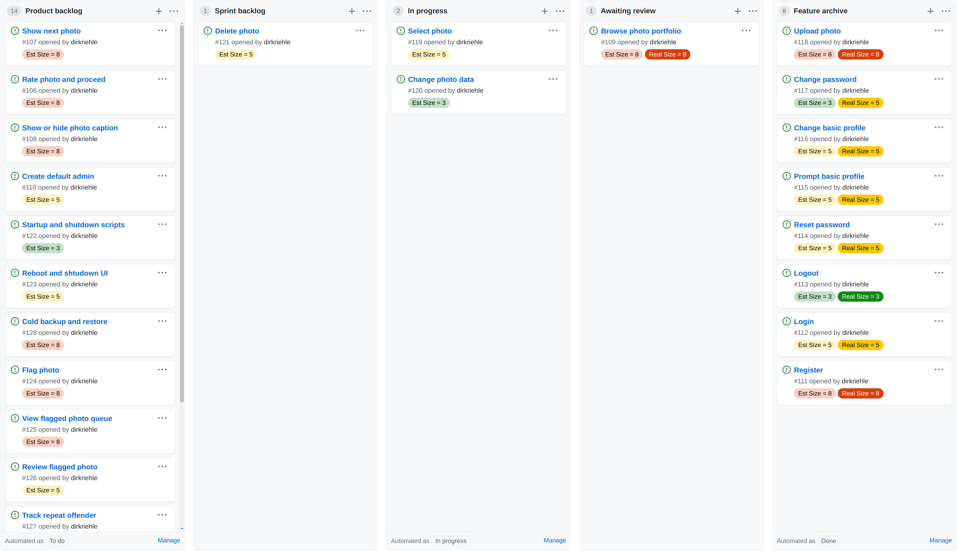

Slide 10
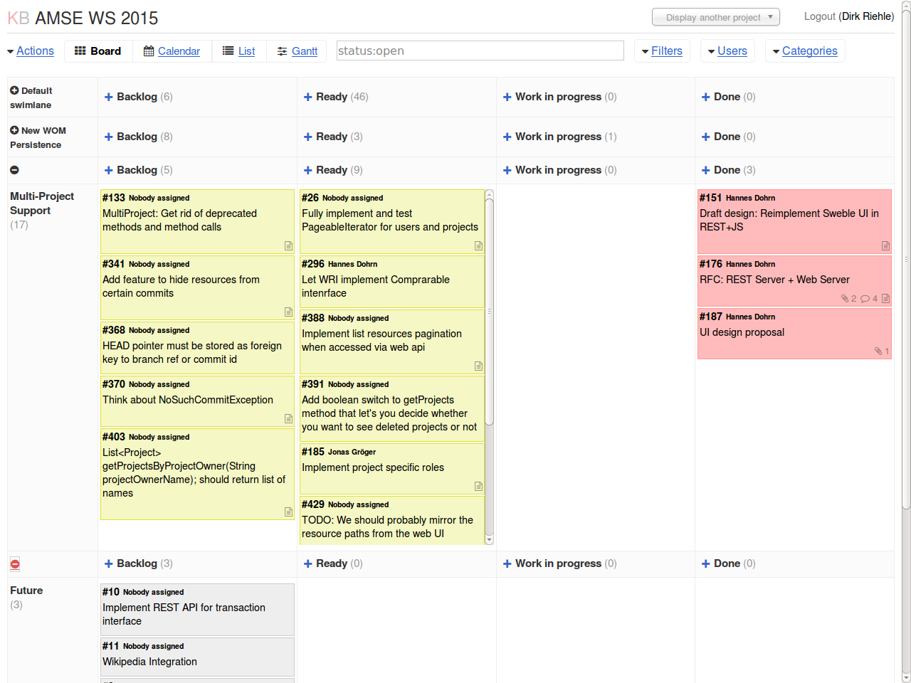

Slide 11
Task Board (Artifact)
Task board (a.k.a. Kanban board)
  Visualizes the progress towards finishing features and the current sprint
  Shows for each feature the progress of implementation
  May break down work into hours

Slide 12
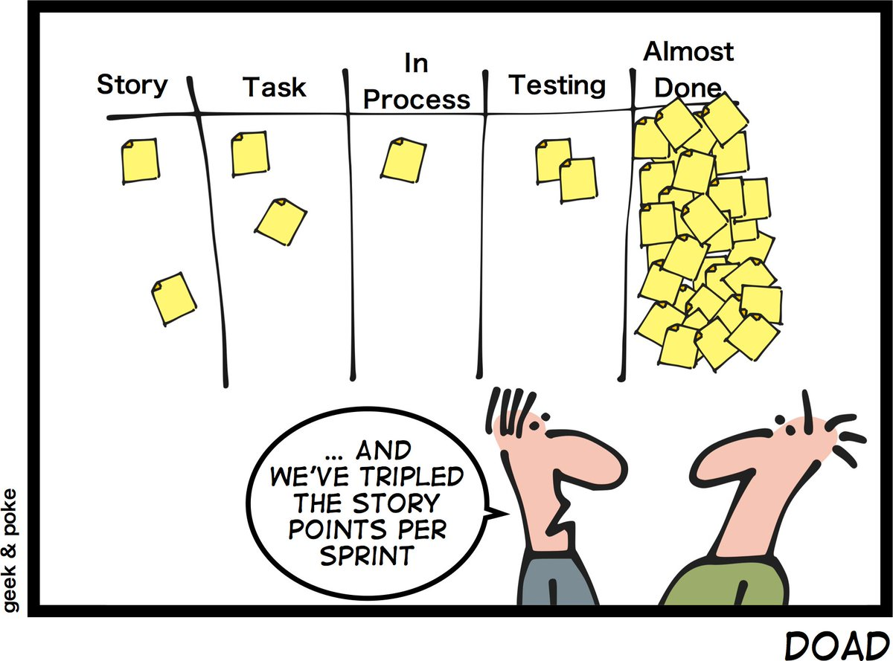
Definition of Almost Done

Slide 13
3. Day Planning

Slide 14
Day Planning (Practices)
Perform Daily Scrum
  Responsible: Scrum master
  Artifacts: Impediment backlog
  Collaborators: Developers

Slide 15
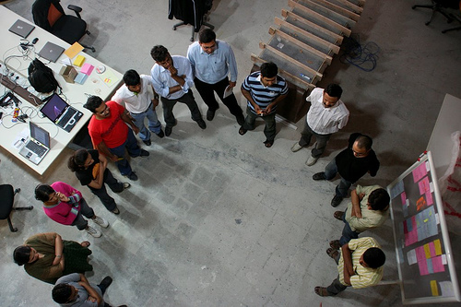

Slide 16
Daily Scrum
Daily Scrum
  Is a daily status meeting to sync on problems and upcoming work
  Is to be kept as short as possible (a.k.a. daily stand-up meeting)
Other properties
  “Pigs” are mandatory, “chicken” are optional, only “pigs” may speak
  Provides only updates, everyone may only speak once
  No discussions allowed, any discussions are taken off-line
  Scrum master to follow-up on problems
Questions asked
  What did you do yesterday?
  What will you be doing today?
  What obstacles are in your way?

Slide 17
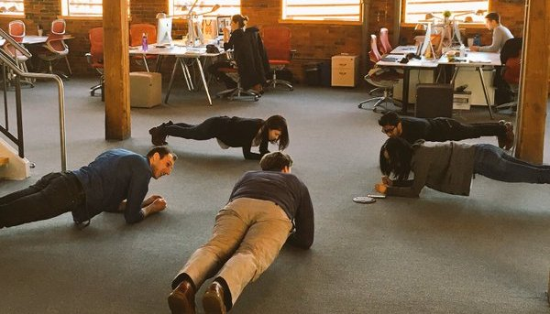
Plank Meetings

Slide 18
4. Code Ownership

Slide 19
Collective Code Ownership (Practice)
Own code collectively
  Responsible: Development team
  Artifacts: Source code
  Collaborators: Developers

Slide 20
Collective Code Ownership
Definition and purpose
  Provide full read and write access to each developer of the collective
  Is to instill a feeling of overall responsibility for the code base
  The opposite of collective code ownership is individual code ownership
Other properties
  Every member of the collective
    Cares about the architecture
    Cares about clean code
    Ensures high quality
  Every single author can
    Implement a feature end-to-end
    Finish a refactoring
    Fix a bug

Slide 21
Programming Standard (Practice)
Use programming standard
  Responsible: Development team
  Artifacts: Programming standard, source code
  Collaborators: Developers

Slide 22
Programming Standard
Definition and purpose
  Is a set of rules and conventions that determines naming, formating and structuring of source code and related artifacts
  Is used to ensure that every developer can read and modify every other developer’s code as easily as possible
Other properties
  Ease reading source code
  Ease navigating code
  Should be mandatory

Slide 23
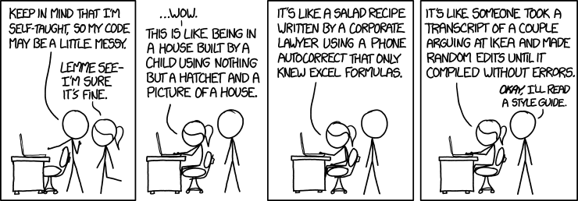
xkcd on Programming Standards

Slide 24
Example Java Programming Standard 1 / 4
3.1.1 Beginning Comments
All source files should begin with a c-style comment that lists the class name, version information, date, and copyright notice:
/*
* Classname
*
* Version information
*
* Date
*
* Copyright notice
*/
...

Slide 25
Example Java Programming Standard 2 / 4
4.2 Wrapping Lines
When an expression will not fit on a single line, break it according to these general principles:
Break after a comma.
Break before an operator.
Prefer higher-level breaks to lower-level breaks.
...

Slide 26
Example Java Programming Standard 3 / 4
6.3 Placement
Put declarations only at the beginning of blocks. (A block is any code surrounded by curly braces "{" and "}".) Don't wait to declare variables until their first use; it can confuse the unwary programmer and hamper code portability within the scope.
void myMethod() {
int int1 = 0; // beginning of method block
if (condition) {
int int2 = 0; // beginning of "if" block
...
}
}
...

Slide 27
Example Java Programming Standard 4 / 4
7.1 Simple Statements
Each line should contain at most one statement. Example:
argv++; // Correct
argc--; // Correct
argv++; argc--; // AVOID!
...

Slide 28
Categories and Examples of Method Types
Query Method | Mutation Method | Helper Method
get method (getter) | set method (setter) | factory method
boolean query method | command method | cloning method
comparison method | initialization method | assertion method
conversion method | finalization method | logging method
... | ... | ...

Slide 29
Get Method (Query Method)
Definition | A get method is a query method that returns a (logical) field of the object.
Also known as | Getter
JDK example | Class Object#getClass() Object Enumeration#nextElement()
Name example | String getComponent(int) Iterable<String> getComponentIterator()
Prefixes | get
Naming | After the prefix, the name of the field being queried follows.

Slide 30
Assertion Method (Helper Method)
Definition | An assertion method is a helper method that tests a condition. If the condition holds, it returns quietly. If it does not, an exception is thrown.
Also known as | -
JDK example | void AccessControlContext#checkPermission(Permission) throws AccessControlException
Name example | void assertIsValidIndex(int) throws InvalidIndexException
Prefixes | assert, check, test
Naming | After the prefix, the condition being checked follows.

Slide 31
Conventions / Patterns Beyond Formatting
Naming conventions
  Attributes, methods
  Classes, packages
  ...
Design conventions
  Collaborations
  Modules, classes
  ...
Package structures
  …
See our Advanced Design and Programming (ADAP) course

Slide 32
Quiz: Software Development
A file may have many authors. Should the names of these authors be listed in the file’s header?
  Yes
  No

Slide 33
5. Build Management

Slide 34
Build Process
Definition
  Is the defined and (ideally automated) process of deriving an installable product from its source artifacts
Purpose
  Defines a standard environment
  Provides developers with setup
  Defines clear commit rules
  Manages test data etc.

Slide 35
Developer Responsibilities
Only work in defined standardized environment
  This ensures no subtle differences to central build process
Only commit / push code that compiles and works
  “Breaking the build” through non-compiling code hurts team
Only commit / push code that passes all the tests
  Failing tests quickly degenerate system (hard to catch-up)

Slide 36
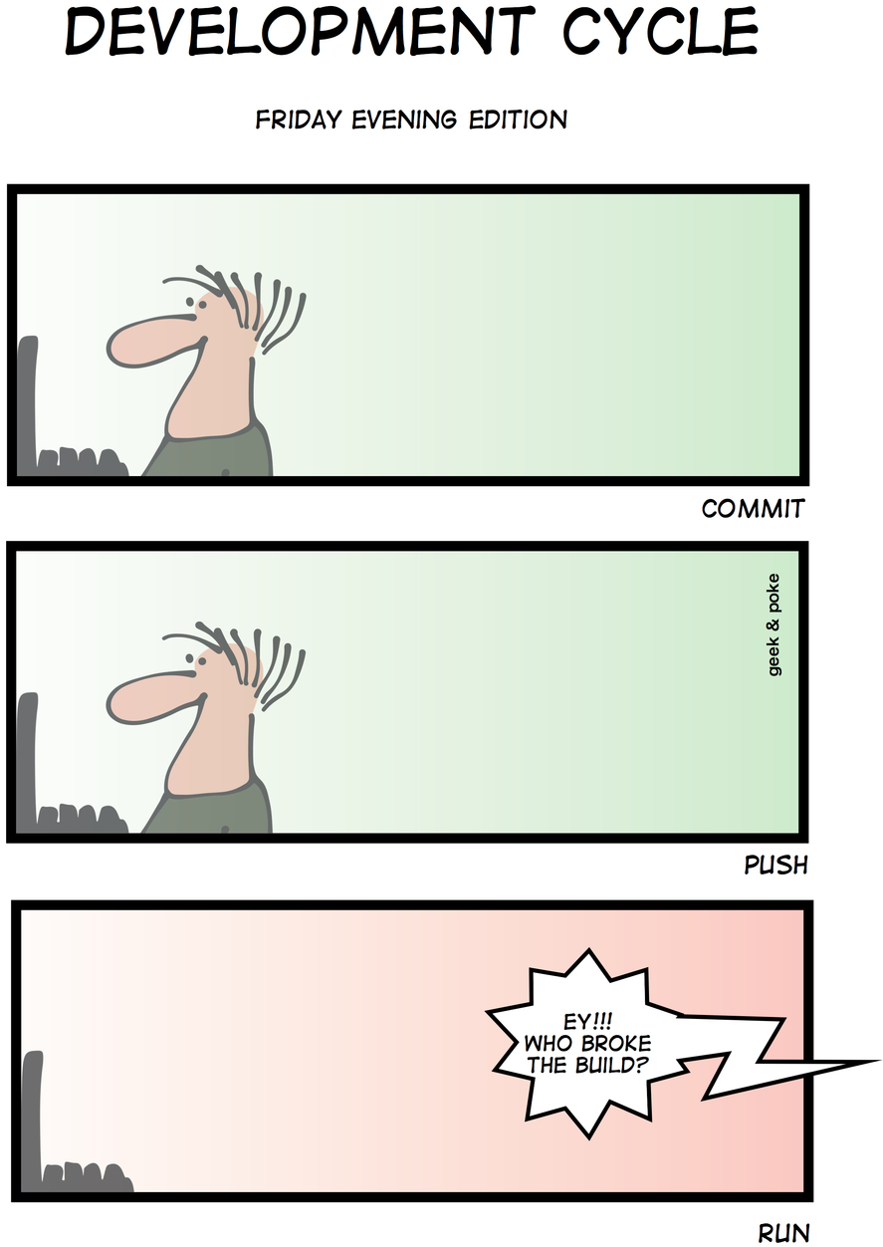

Slide 37
Build Asset Management
Management by hand
  Libraries are curated by hand
Automated management
  Libraries are pulled in automatically
Bill of materials
  Possibly generated automatically

Slide 38
Quiz: Supply Chain Effects
Last week you delivered your product release to your client. The phone rings and an angry client is on the line, complaining about missing their schedule. What might have gone wrong?
  The client’s development team objected
  The client’s quality assurance unit objected
  The client’s legal team objected
  All of the above

Slide 39
Review / Summary of Session
Development planning
  Stories vs. tasks
  Daily scrum
Source code and coding
  Collective code ownership
  Programming guidelines
  Other conventions
Build process

Slide 40
Thank you! Questions?
dirk.riehle@fau.de – http://osr.cs.fau.de
dirk@riehle.org – http://dirkriehle.com – @dirkriehle
DR

Slide 41
Credits and License
Original version
  © 2021 Dirk Riehle, some rights reserved
  Licensed under Creative Commons Attribution 4.0 International License
Contributions
  None yet

